Slide 1
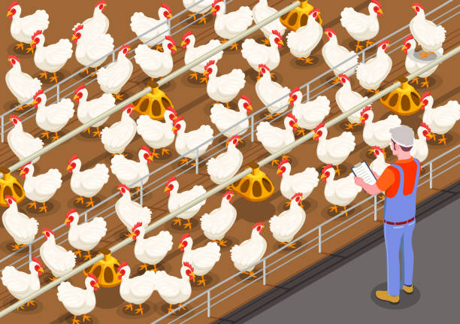

Feathered Guardian: A Smart Poultry Litter Tracking and Alert System

Slide 2

Project Leadership
Sharat Manikonda
Director at Innodatatics and Sponsor
linkedin.com/in/sharat-chandra

Slide 3
Team Members
Name:Parvathy K R
www.linkedin.com/in/parvathy-k-r

Slide 4

Contents
Business objective
Business Constraints
Project Architecture
Data collection and details
Exploratory Data Analysis
Visualization
Modeling
Evaluation
Deployment
Notes:
Change

Slide 5
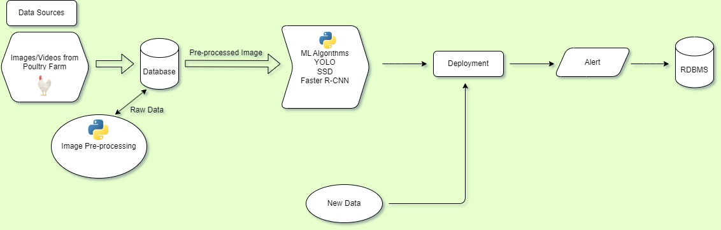
Project Overview and Scope

Slide 6
Business Problem
Neglecting proper litter management in poultry farming creates an environment that contributes to the buildup of pathogens and ammonia. This posses a threat to the respiratory well-being of birds, increases the risk of diseases and undermines the overall success and sustainability of the poultry enterprise.

Slide 7
Business Objective
Objective
Constraints
Maximize poultry health
Minimize the cost of the solution.

Slide 8
CRISP-ML(Q) Methodology
There are six stages of CRISP-ML(Q) Methodology
1.Business and data understanding
2.Data preparation
3.model building
4.Model evaluation
5.Model deployment
6.Monitoring and maintenance

Slide 9
Technical Stacks
Data Annotation: Used Roboflow for image annotation.
Model Building: You Only Look Once (YOLOv8)
Integration & Deployment: Streamlit application

Slide 10
Data Collection and Understanding
Data collection: Frames from the videos of litter management has been divided to team members for annotation and merged together by WeTransfer.
Data Understanding: Collected data are images in unstructured form.

Slide 11
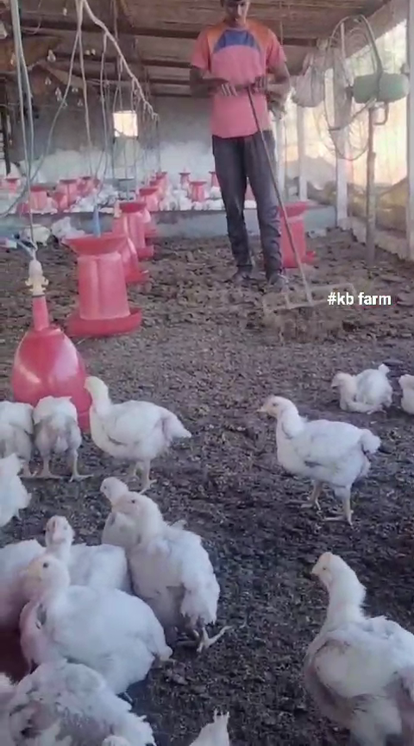
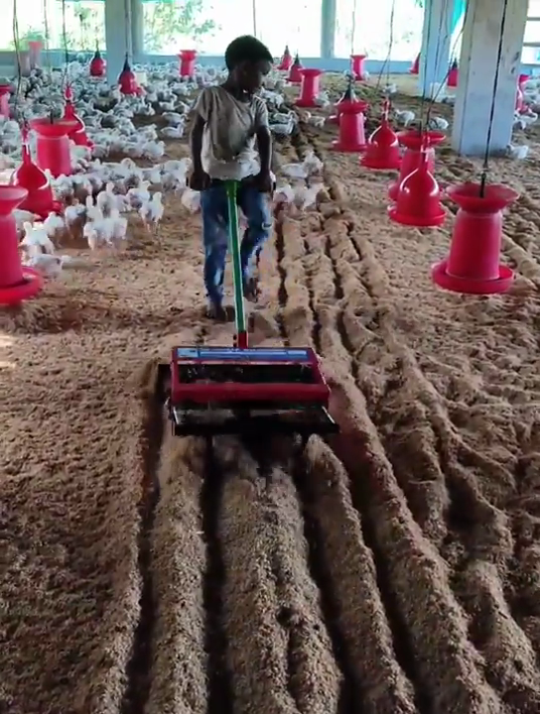
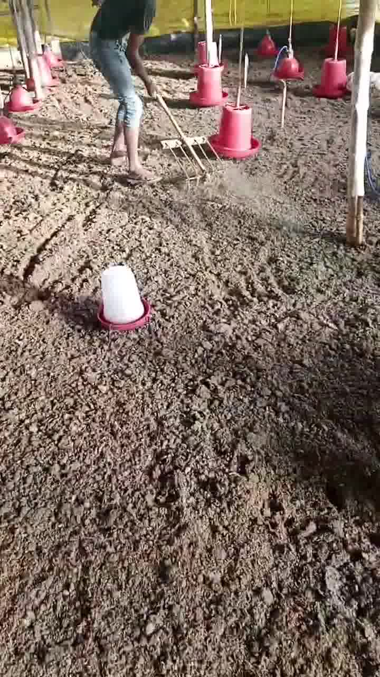
Data Information
Example Images collected from litter racking videos

Slide 12
System Requirements
Basic Usage:
Operating System: Any major OS (Windows, macOS, Linux)
CPU: Intel Core i5 or equivalent processor recommended, can work on lower-end CPUs but with slower performance
RAM: 8GB minimum, 16GB recommended for faster processing
Storage: 20GB+ free space for model files and intermediate data
Python: Python 3.7+ (including required models like Roboflow, Ultralytics )

Slide 13
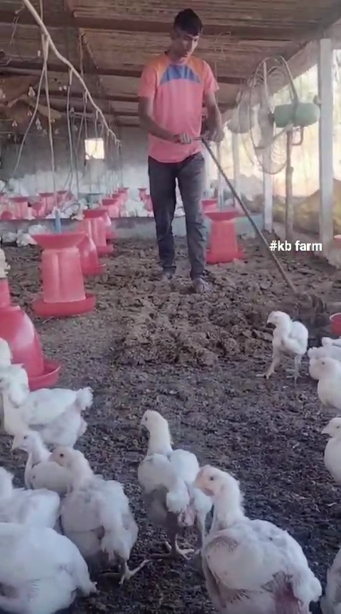
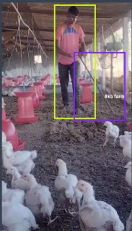
Data Preprocessing
Before Annotation
After Annotation
Notes:
Keep observations

Slide 14
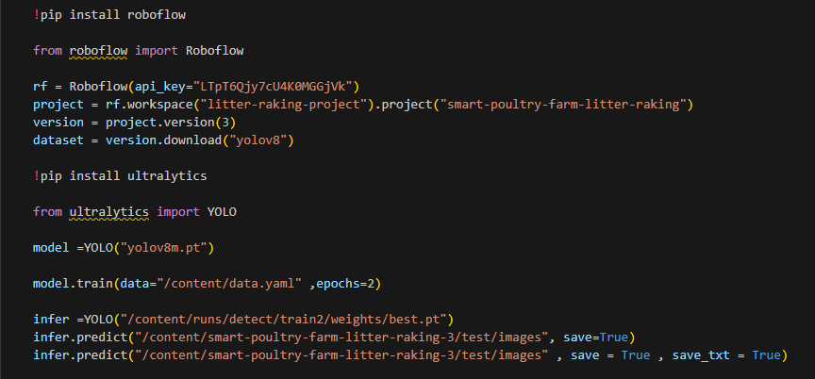
Model Building
YOLOv8m is used for model building
Notes:
classification is the task of predicting a discrete class label. Regression is the task of predicting a continuous quantity.
What is classification techniques in machine learning?
The Classification algorithm is a Supervised Learning technique that is used to identify the category of new observations on the basis of training data. In Classification, a program learns from the given dataset or observations and then classifies new observation into several classes or groups.
What is regression techniques in machine learning?
Regression is a technique for investigating the relationship between independent variables or features and a dependent variable or outcome. It's used as a method for predictive modeling in machine learning, in which an algorithm is used to predict continuous outcomes.

Slide 15
Model Deployment - Strategy
Streamlit is used for the model deployment. Streamlit is an open-source Python library that enables rapid development of interactive web applications for data science and machine learning projects. With its intuitive and easy-to-use interface, developers can create powerful applications with minimal effort. Streamlit simplifies the process of building data-driven applications by providing a single framework for data visualization, user interaction, and deployment.

Slide 16
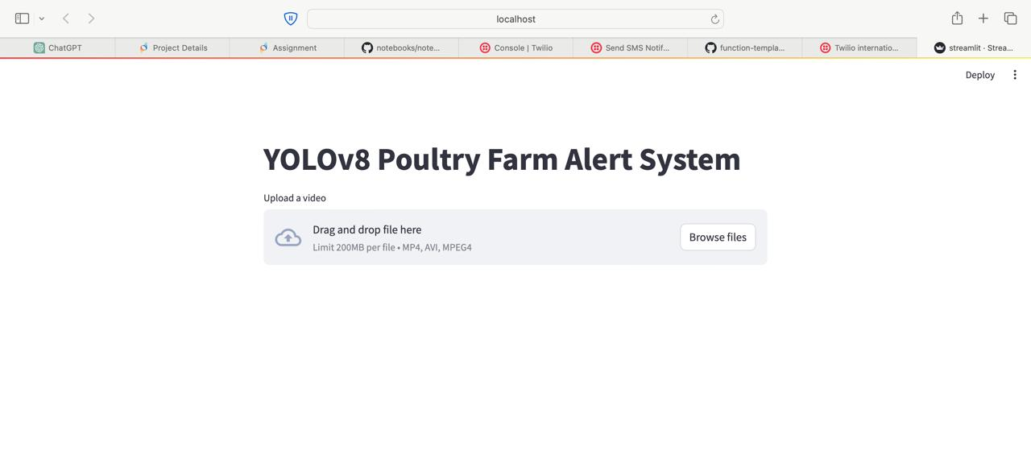
Screen shot of output

Slide 17
Challenges
Data Accuracy and Integration
Sensor Reliability
Environmental Factors
Data Management and Storage
Data Interpretation and Analysis
User Interface and Accessibility
Regulatory Compliance
Cost Constraints

Slide 18
Future Scopes
In the future, the scope of the poultry litter tracking and alert system project extends towards a more integrated and intelligent approach to poultry waste management. By leveraging advancements in IoT and automation, the system can evolve to autonomously regulate ventilation, feeding, and waste disposal processes based on real-time data analysis. Predictive analytics and machine learning algorithms offer opportunities to forecast litter conditions and optimize management strategies proactively. Enhanced reporting and visualization capabilities enable stakeholders to gain comprehensive insights into litter trends and environmental impacts.

Slide 19
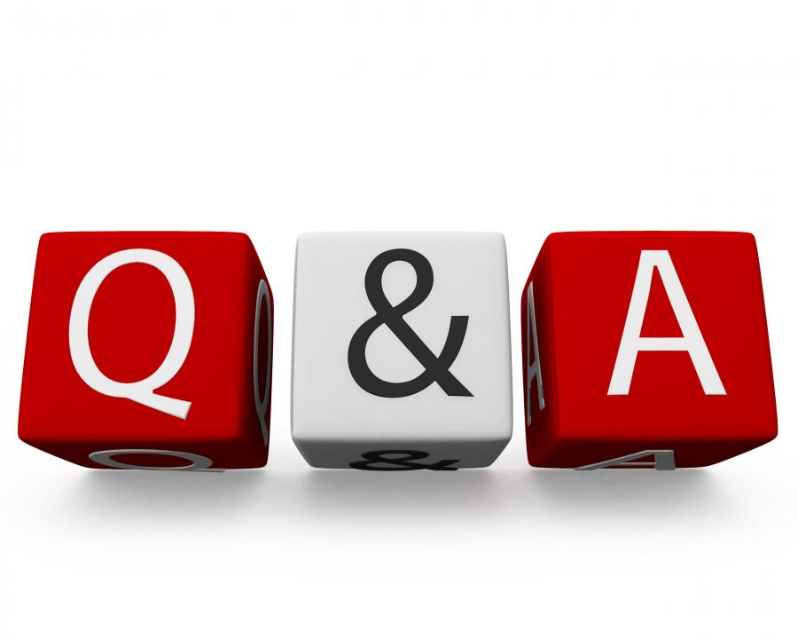
Queries ?

Slide 20


